Slide 1


Feature Driven Development (FDD)
Feature Driven Development (FDD) is an agile framework. It organizes software development around delivering features. FDD is known for short iterations and frequent releases. Developers prioritize client requests and respond quickly, satisfying clients. Jeff De Luca and Peter Coad developed FDD in 1997.
by Mokaya Favian

Slide 2
FDD: Ideal Project Types
Large Development Teams
Predefined Standards
Quick Releases
FDD is ideal for projects with large development teams. It helps maintain structure and coordination.
Projects following predefined standards benefit from FDD's structured approach.
FDD supports quick releases, ensuring timely delivery of value to clients.

Slide 3

FDD Overview: Core Focus
1
Tangible Software
2
Agility
3
Complexity Management
Delivers working software through iterative, feature-based development.
Ensures continuous progress through structured steps while maintaining flexibility.
Suited for large and complex projects.

Slide 4





Five Main Steps of FDD
Develop Overall Model
Create a high-level domain model to understand system structure.
Build Features List
Break down functionalities into small, client-valued features.
Plan by Feature
Organize and prioritize features into development iterations.
Design by Feature
Define the feature's design, involving domain and development experts.
Build by Feature
Implement, test, and integrate each feature incrementally.

Slide 5
FDD vs. Other Agile Methods
Scrum and Kanban
FDD Focus
Extreme Programming (XP)
Emphasize tasks and workflow.
Focuses on feature completion as the core unit of development.
Provides more structured modeling and planning upfront compared to XP.

Slide 6
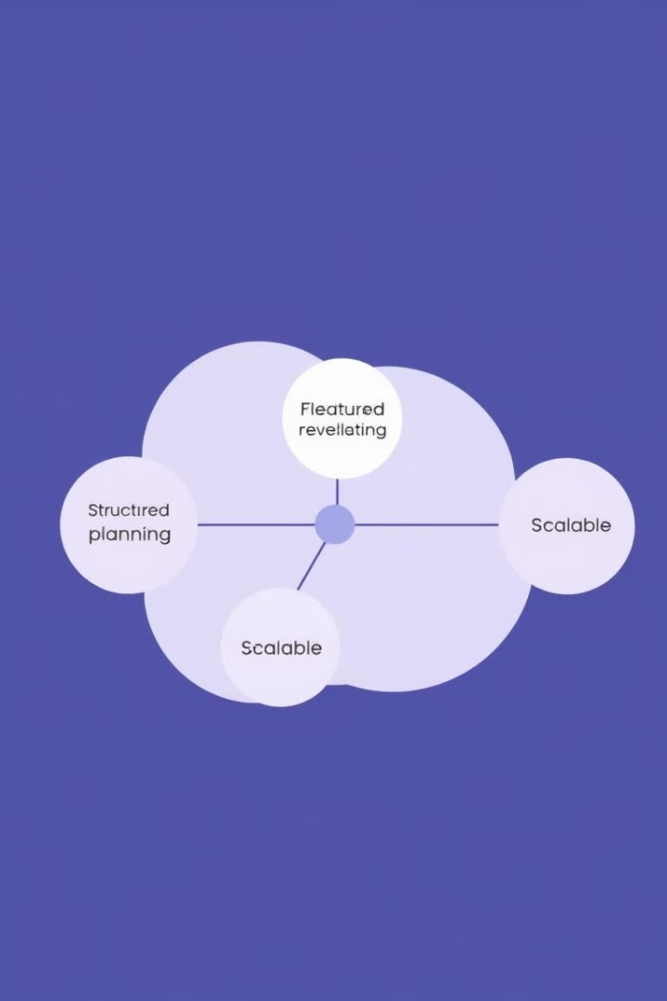
Advantages of FDD
1
Client-Valued Focus
2
Defined Scope
Aligns development with client needs and delivers tangible value.
Provides a clear, structured roadmap minimizing ambiguity and scope creep.
3
Scalability
Suited for large projects, enabling parallel work without losing coherence.

Slide 7
Improved Collaboration and QA
In-Team Collaboration
Quality Assurance
Regular Builds
Documentation improves communication, ensuring a common goal.
Maintains high quality and consistency across the codebase through reviews.
Frequent integration identifies issues early, contributing to system stability.

Slide 8

Disadvantages of FDD
1
High Initial Overhead
2
Limited Flexibility
3
Not Ideal for Small Projects
Planning and design can be time-consuming, delaying development start.
Structured process can be less flexible when requirements change.
Complexity may be overkill; smaller teams may prefer Scrum or Kanban.

Slide 9




FDD Case Studies
Banking App Development
E-commerce Platform
Game Development
Faster deployment with minimal bugs, keeping customers engaged.
Increased user engagement, better retention, and reduced downtime.
Faster patch releases, improved gameplay, and better satisfaction.

Slide 10
FDD in a Nutshell
Structured Agile
Feature Focus
FDD is a structured yet flexible Agile methodology.
Focuses on delivering small, valuable features continuously.
Best Use Cases
Organization & Adaptability
Best suited for large, complex projects requiring iterative feature releases.
Helps teams maintain organization while remaining adaptable.

